Slide 1
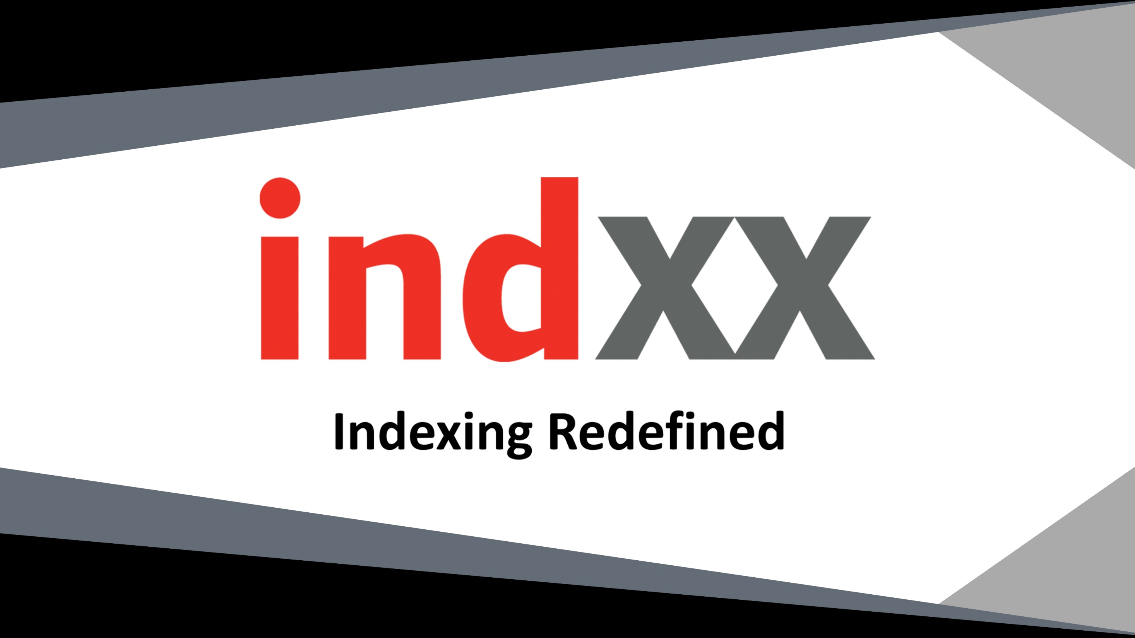


Slide 2
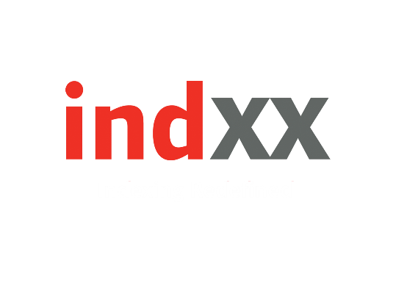

36
Indxx Blockchain Index
ILEGR
The Indxx Blockchain Index tracks the performance of listed common stocks of companies with their primary listing in Developed or Emerging market countries that are either actively using, investing in, developing, or have products that are poised to benefit from blockchain technology.

Slide 3

36
Investment Rationale
According to Santander, a Spanish banking group, by 2022, distributed ledgers could cut the industry’s bills by up to $20 billion a year.
According to the World Economic Forum, a reputed Swiss non-profit foundation, by 2027, 10% of the global GDP will be stored in the blockchain technology.
According to Forbes magazine, 90% of major North American and European banks are exploring blockchain technology.
According to CEB insights, blockchain technologies attracted $1 billion of venture capital in 2015.
According to a Bain report, international payments, which has $150 billion - $200 billion in bank deposits, and trade finance, which has $23 billion bank revenue pool, have the strongest potential for distributed ledgers.

Slide 4

36
Tiered Scoring System
Tier 1 - Active Enablers
Active Enablers are the companies that:
Are actively developing blockchain technology systems for their own use or for sale and support to other companies
Are direct service providers of blockchain technology
Have business models that rely on delivering products or services that utilize blockchain technology
Tier 2 - Active Users
Active Users are companies that:
Are using blockchain technology which is generally supported by an Active Enabler
Have at least one use or test case of using blockchain technology

Slide 5
36
Index Characteristics
Base Date
No. of Constituents
Dividend Yield
Beta vs Indxx 500 (TR) Index
Correlation vs. Indxx 500 (TR) Index
52 Week High/Low
Live Calculation Date
3/18/2016
67
1.74%
1.18
0.74
1989/1426
12/07/2017

Slide 6
36
Methodology Construction
Universe
Market Cap Eligibility
Free Float
Adequate Liquidity
Security Selection
Weighting Method
Reconstitution
The security should either have its primary listing or be incorporated in Developed and Emerging markets as defined by Indxx
Companies with a market capitalization of $250 million or greater
At least 20% of shares outstanding must be available
Companies with their last 6 months ADTV of $1 million or greater
Extensive research performed by Indxx along with the tiered scoring system
Equally weighted with evenly balanced exposure to both the tiers
Semi-annually, at the close of the third Friday of March and September

Slide 7
36
Country Breakdown
Size Exposure

Slide 8
36
Performance Chart

Slide 9
36
Calendar Year Returns
2016
2017
Indxx Blockchain Index
43.84%
36.55%
Indxx 500 (TR) Index
11.23%
21.87%
Calendar Year Volatility
2016
2017
Indxx Blockchain Index
16.90%
10.49%
Indxx 500 (TR) Index
10.49%
6.65%

